Slide 1
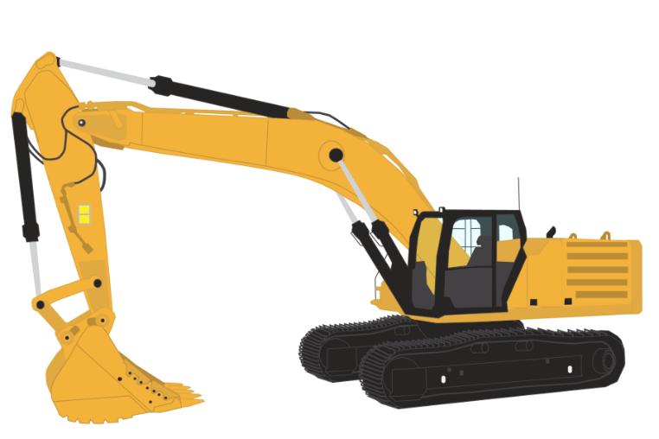

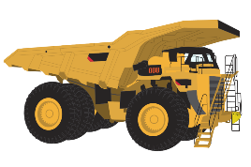
Project 2
Interactive mining injury dashboard

Slide 2

Contents
Data Story/Sourcing
ETL Process
Dashboard
Visualization 1 – Mine details data tablet
Visualization 2 – Dual Dataset Injury Donut
Visualization 3 – Stacked Bar Incident Activities by Month
Visualization 4 - Horizontal Bar of Incidents By Category

Slide 3
Data Story/Sourcing

Slide 4
ETL Process
First bullet point here
Second bullet point here
Third bullet point here
Step 1
Task Description
Task Description
Step 2
Task Description
Task Description
Step 3
Task Description
Task Description

Slide 5
Dashboard

Slide 6
Visualization 1 Mine details data tablet

Slide 7
Visualization 2 Dual Dataset Injury Donut

Slide 8
Visualization 3 Stacked Bar Incident Activities by Month

Slide 9
Visualization 4 Horizontal Bar of Incidents By Category

Slide 10
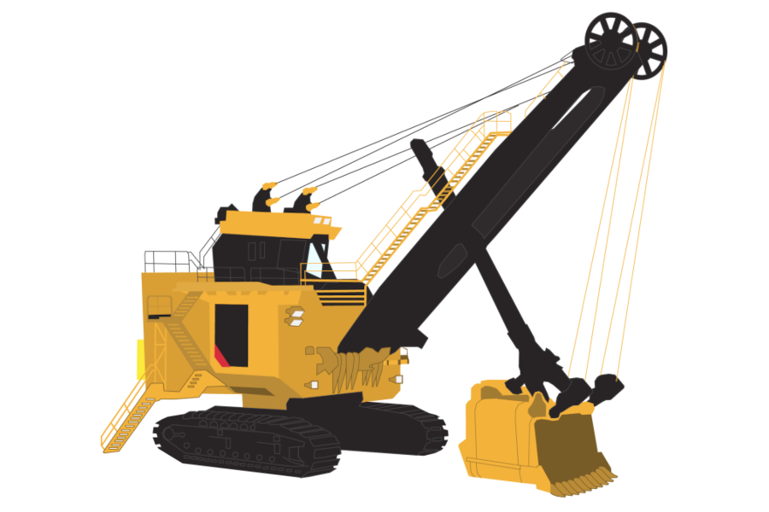

Thankyou for listening
Stay safe out there!

